Slide 1



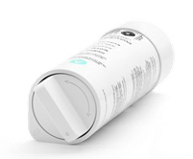

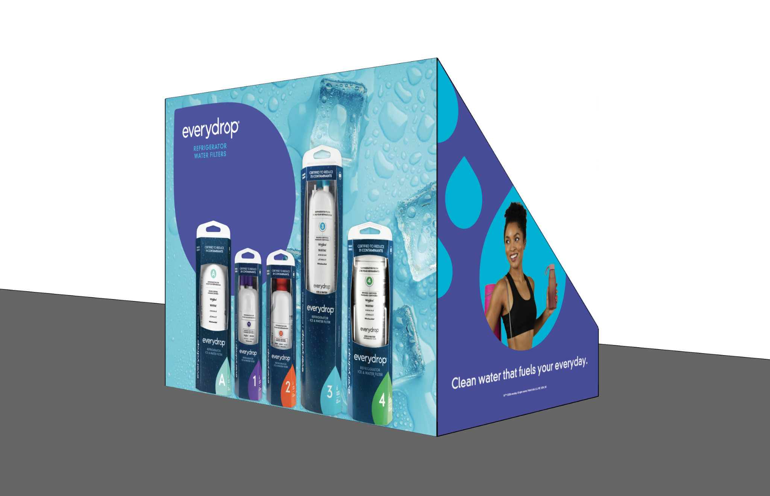
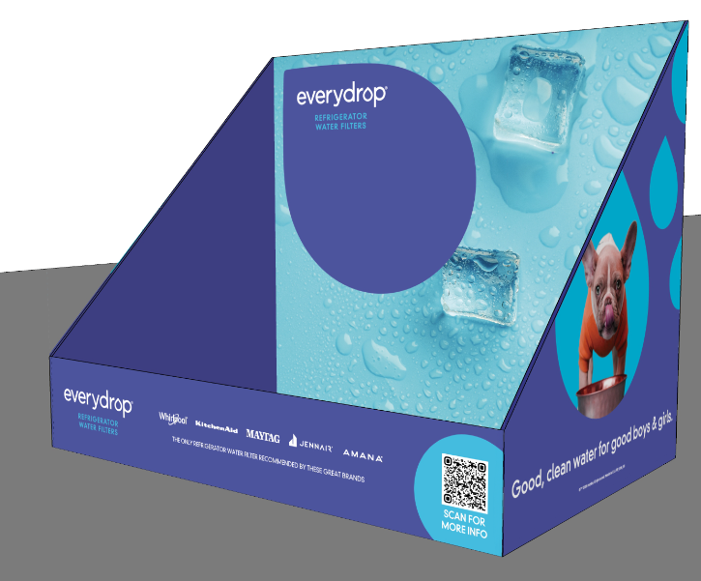



everydrop Countertop Display with NEW Filter A
Save 10%
Send orders to kmattes@saleslinkco.com
Savings only applies for display. Individual filters are not available for drop ship unless member has an active Whirlpool account

Slide 2
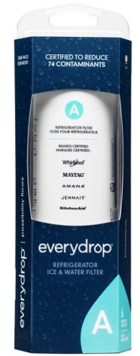
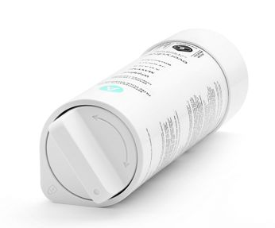
Filter A Refrigerator Model List
No other brand of filter will work in Filter A Whirlpool, Maytag and KitchenAid models
Whirlpool Model | Old Digit - Needs Filter 4 | New Digit - Needs Filter A
WRX735SDHZ | WRX735SDHZ09 | WRX735SDHZ10
WRX735SDHW | WRX735SDHW08 | WRX735SDHW09
WRX735SDHV | WRX735SDHV08 | WRX735SDHV09
WRX735SDHB | WRX735SDHB08 | WRX735SDHB09
WRFF5333PZ | WRFF5333PZ00 | WRFF5333PZ01
WRFF5333PW | WRFF5333PW00 | WRFF5333PW01
WRFF5333PV | WRFF5333PV00 | WRFF5333PV01
WRFF5333PB | WRFF5333PB00 | WRFF5333PB01
WRF555SDHW | WRF555SDHW07 | WRF555SDHW08
WRF555SDHV | WRF555SDHV08 | WRF555SDHV09
WRF555SDHB | WRF555SDHB07 | WRF555SDHB08
WRF555SDFZ | WRF555SDFZ16 | WRF555SDFZ17
WRF540CWHZ | WRF540CWHZ10 | WRF540CWHZ11
WRF540CWHW | WRF540CWHW08 | WRF540CWHW09
WRF540CWHV | WRF540CWHV08 | WRF540CWHV09
WRF540CWHB | WRF540CWHB08 | WRF540CWHB09
WRF535SWHZ | WRF535SWHZ10 | WRF535SWHZ11
WRF535SWHW | WRF535SWHW08 | WRF535SWHW09
WRF535SWHV | WRF535SWHV08 | WRF535SWHV09
WRF535SWHB | WRF535SWHB08 | WRF535SWHB09
Maytag Model | Old Digit - Needs Filter 4 | New Digit - Needs Filter A
MRFF5036PZ | MRFF5036PZ00 | MRFF5036PZ01
MRFF5033PZ | MRFF5033PZ00 | MRFF5033PZ01
MFI2570FEZ | MFI2570FEZ13 | MFI2570FEZ14
MFI2570FEW | MFI2570FEW08 | MFI2570FEW09
MFI2570FEB | MFI2570FEB08 | MFI2570FEB09
MFC2062FEZ | MFC2062FEZ11 | MFC2062FEZ12
KitchenAid Model | Old Digit - Needs Filter 4 | New Digit - Needs Filter A
KRFF305ESS | KRFF305ESS07 | KRFF305ESS08
KRFF305EBS | KRFF305EBS06 | KRFF305EBS07
KRFF302ESS | KRFF302ESS06 | KRFF302ESS07
KRFF302EBS | KRFF302EBS05 | KRFF302EBS06
KRFC300EWH | KRFC300EWH10 | KRFC300EWH11
KRFC300ESS | KRFC300ESS10 | KRFC300ESS11
KRFC300EBS | KRFC300EBS08 | KRFC300EBS09

Slide 3
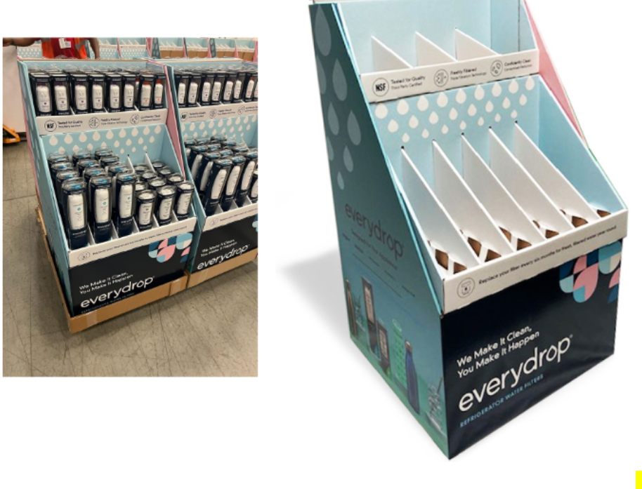
everydrop Filter Quarter Pallet Display
Save 15%
Send orders to kmattes@saleslinkco.com
Savings only applies for display. Individual filters are not available for drop ship unless member has an active Whirlpool account

