Slide 1



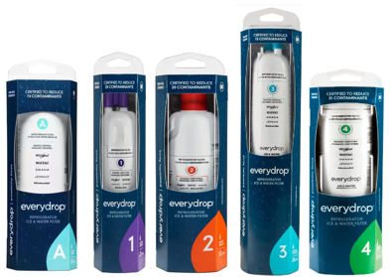
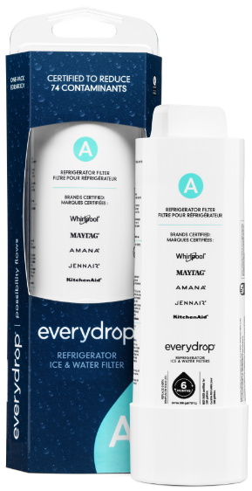
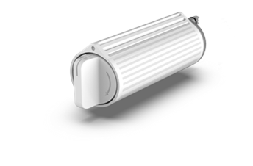
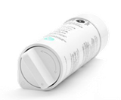
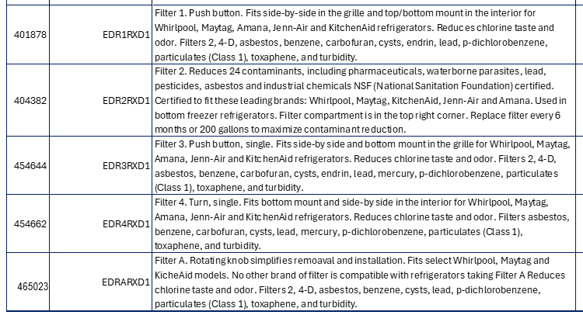

MARKET BULLETIN #3899
Save up to 15% on Whirlpool everydrop refrigerator filters
All items on new updated 2’ Water Filter POG #40-565
Filter A (465023) NEW Warehouse Item
Filters Out 74 Contaminants including lead, pesticides, and pharmaceuticals
No other branded filter works with Whirlpool refrigerators which take new Filter A
Scan for Filter Finder

